Slide 1

8th Grade Math: Pre-Algebra
Unit 5, Lesson 1 Determining Solutions to Inequalities Volume 1, pg. 177

Slide 2


Benchmark
MA.8.AR.2.2
Solve two-step linear inequalities in one variable and represent solutions algebraically and graphically.
volume 1, pg. 177

Slide 3
Integrated Mathematical Thinking and Reasoning Standards
MA.K12.MTR.1.1 Actively participate in effortful learning both individually and collectively.
MA.K12.MTR.2.1 Demonstrate understanding by representing problems in multiple ways.
MA.K12.MTR.4.1 Engage in discussions that reflect on the mathematical thinking of self and others.
MA.K12.MTR.5.1 Use patterns and structure to help understand and connect mathematical concepts.
MA.K12.MTR.6.1 Assess the reasonableness of solutions.
volume 1, pg. 177

Slide 4

Learning Targets
I can determine which value from a set of values makes an inequality true.
I can determine if a value on a number line represents a solution set.
I can solve inequalities and represent solutions on a number line.
volume 1, pg. 177

Slide 5

Warm-Up
volume 1, pg. 177

Slide 6
5.1.1 Warm-Up: Careers - Forester
Foresters have a wide range of duties, depending on who their employer is. Some primary duties of foresters are drawing up plans to regenerate forested lands, monitoring the progress of those lands, and supervising tree harvests. Another duty of a forester is devising plans to keep forests free from disease, harmful insects, and damaging wildfires.
Why do you think being an effective communicator and a team player is essential to the job?
Describe a time when you had to be an effective communicator and team player.
volume 1, pg. 177

Slide 7

Exploration
volume 1, pg. 178

Slide 8

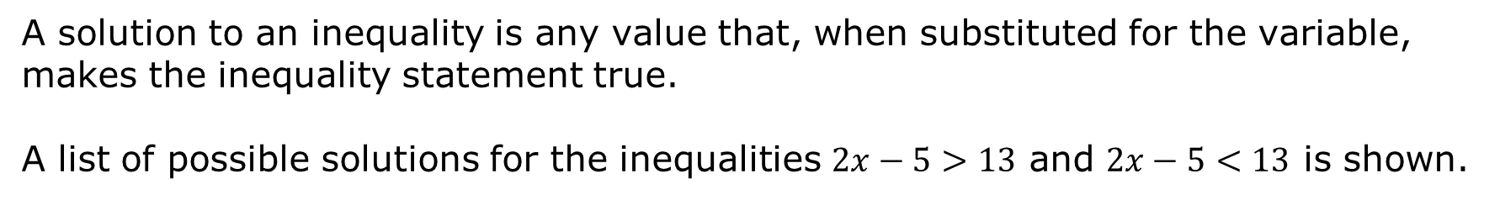
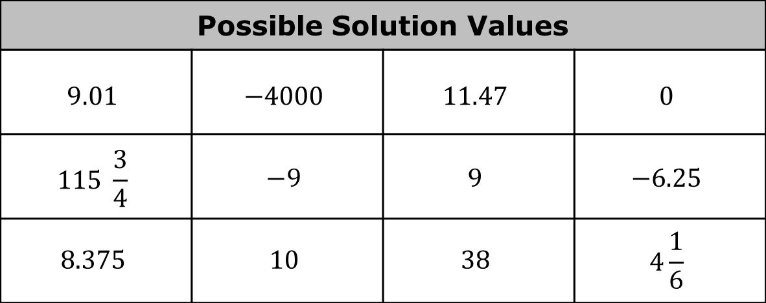
5.1.2 Exploration: Is It a Solution?
A solution to an inequality is any value that, when substituted for the variable, makes the inequality statement true.
A list of possible solutions for the inequalities $2x−5>13$ and $2x−5<13$ is shown.
Possible Solution Values
$$9.01$$ | $$−4000$$ | $$11.47$$ | $$0$$
$$115 \frac{3}{4}$$ | $$−9$$ | $$9$$ | $$−6.25$$
$$8.375$$ | $$10$$ | $$38$$ | $$4\frac{1}{6}$$
volume 1, pg. 178

Slide 9
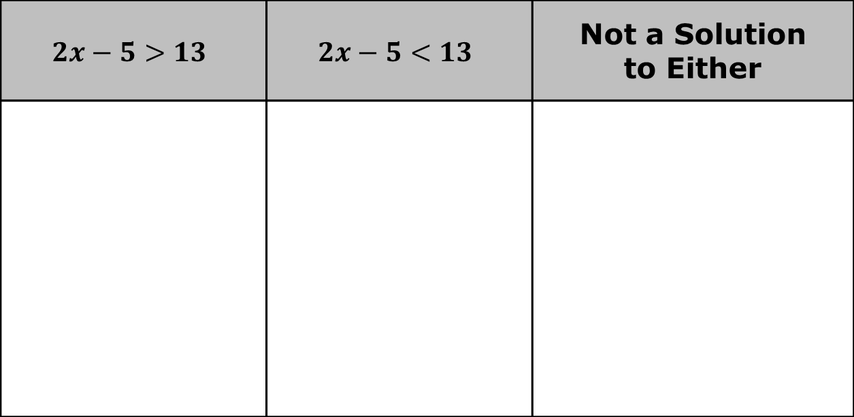
Determine whether each of the possible values is a solution to the given inequalities.
Record the solutions in the table.
$$2x−5>13$$ | $$2x−5<13$$ | Not a Solution to Either
volume 1, pg. 178

Slide 10

Explain the strategy you used to identify solutions.
An inequality has infinite solutions and can be represented on a number line.
volume 1, pg. 178

Slide 11
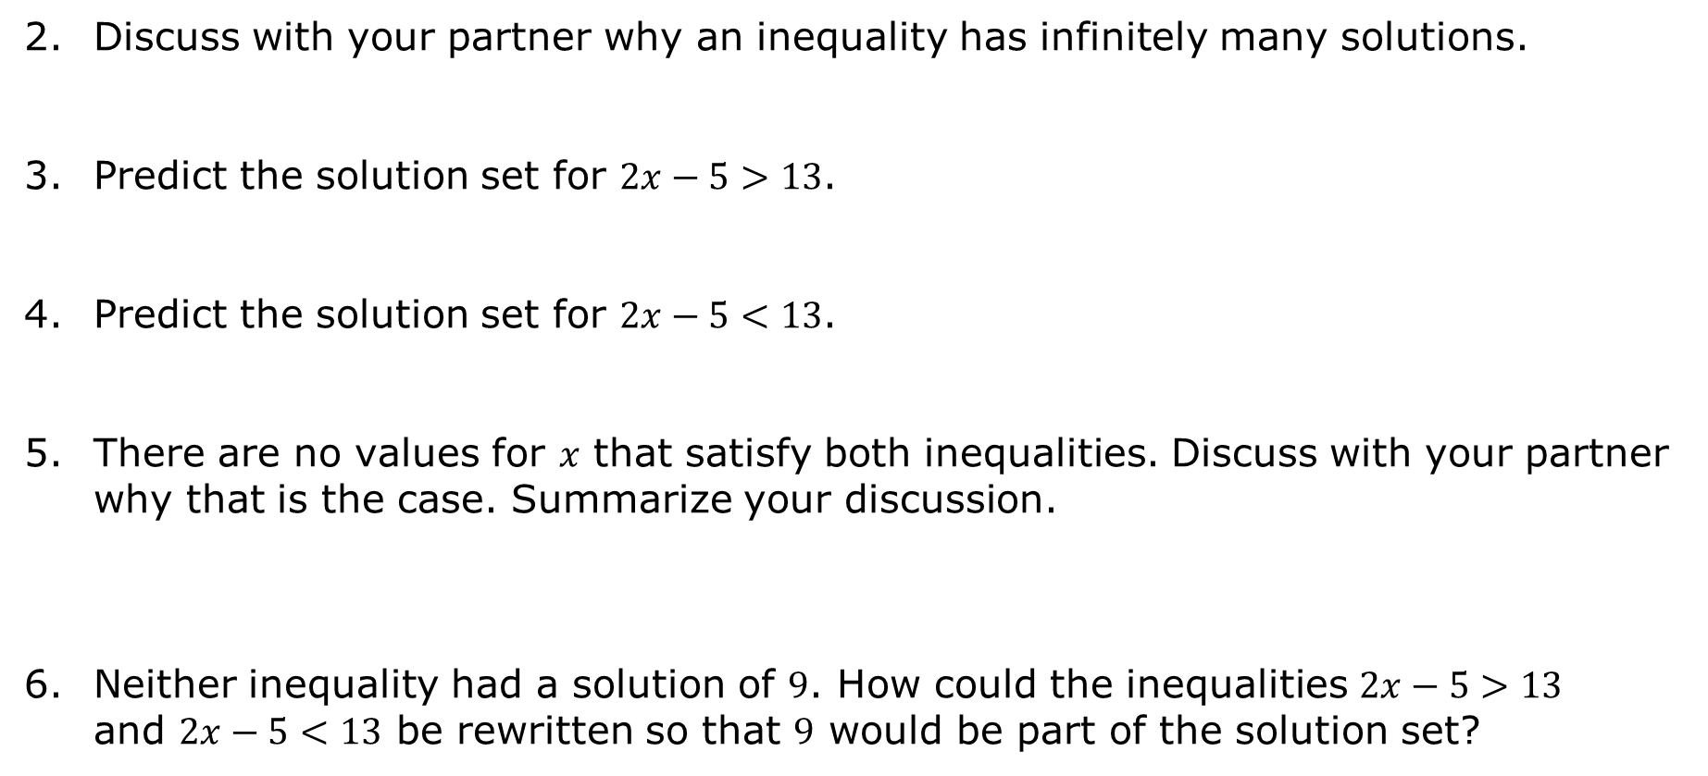
Discuss with your partner why an inequality has infinitely many solutions.
Predict the solution set for $2x−5>13$.
Predict the solution set for $2x−5<13$.
There are no values for $x$ that satisfy both inequalities. Discuss with your partner why that is the case. Summarize your discussion.
Neither inequality had a solution of $9$. How could the inequalities $2x−5>13$ and $2x−5<13$ be rewritten so that $9$ would be part of the solution set?
volume 1, pg. 178

Slide 12

Guided Practice
volume 1, pg. 179

Slide 13


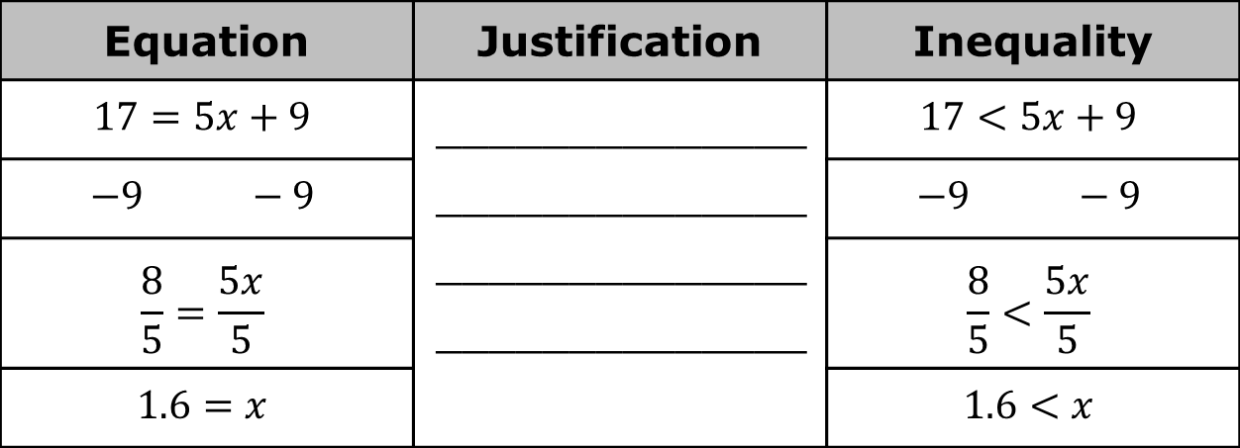
5.1.3 Guided Practice: Solving Two-Step Inequalities
Inequalities can be solved using similar strategies that are used for solving equations.
The work for solving the equation $17=5x+9$ and the work for solving the inequality $17<5x+9$ is shown.
Complete the table with the justification of each step used for solving the equation and the inequality.
Equation | Justification | Inequality
$$17=5x+9$$ | ______________ ______________ ______________ ______________ | $$17<5x+9$$
$$−9 −9$$ |  | $$−9 −9$$
$$\frac{8}{5}=\frac{5x}{5}$$ |  | $$\frac{8}{5}<\frac{5x}{5}$$
$$1.6=x$$ |  | $$1.6<x$$
volume 1, pg. 179

Slide 14
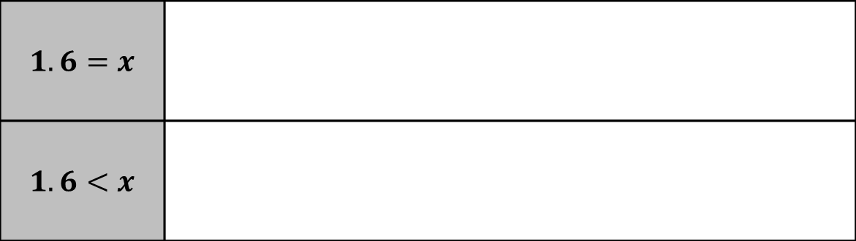
The solution for the equation and the solution set for the inequality is shown.
Discuss with your partner the similarities and differences between solving and graphing the solutions for equations and inequalities. Summarize your discussion.
$$1.6=x$$
$$1.6<x$$
volume 1, pg. 179

Slide 15

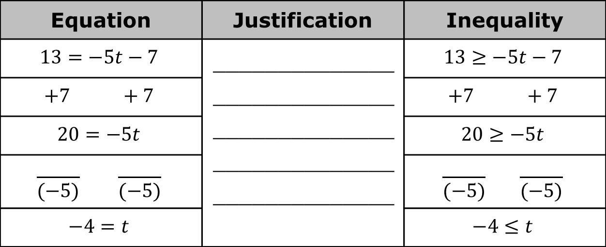
The work for solving the equation $13=−5t−7$ and the inequality $13≥−5t−7$ is shown.
Complete the table with the justification of each step used for solving the equation and the inequality.
How did the final step of solving the inequality $13≥−5t−7$ differ from the final step of solving the inequality $17<5x+9$?
Equation | Justification | Inequality
$$13=−5t−7$$ | ______________ ______________ ______________ ______________ ______________ | $$13≥−5t−7$$
$$+7 +7$$ |  | $$+7 +7$$
$$20=−5t$$ |  | $$20≥−5t$$
$$\frac{ }{(−5)} \frac{ }{(−5)}$$ |  | $$\frac{ }{(−5)} \frac{ }{(−5)}$$
$$−4=t$$ |  | $$−4≤t$$
volume 1, pg. 179

Slide 16
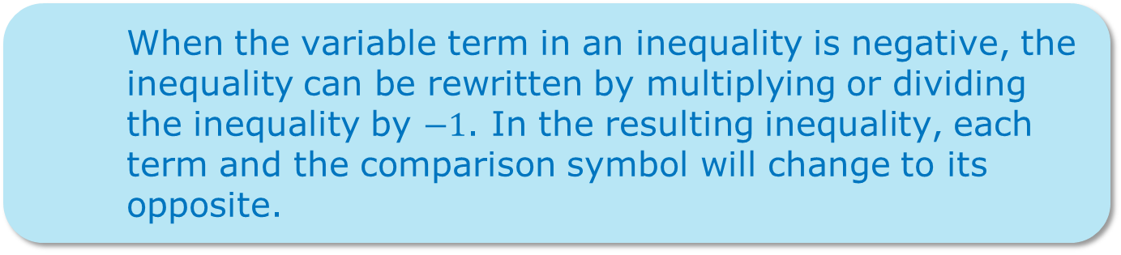
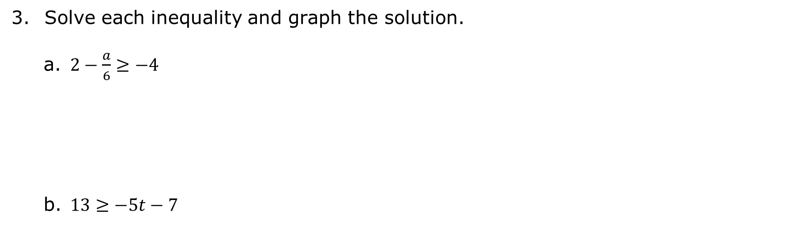
Solve each inequality and graph the solution.
$2−\frac{a}{6}≥−4$
$13≥−5t−7$
volume 1, pg. 180

Slide 17

Your Turn
volume 1, pg. 180

Slide 18

5.1.4 Your Turn!
Solve each inequality and graph the solution.
$56≥8x+21$
$−2.7−0.5t>8.3$
$6+\frac{3}{4}k<−12$
volume 1, pg. 180

Slide 19

Collaboration
volume 1, pg. 181

Slide 20

5.1.5 Collaboration: Matching Inequalities
Work with your partner to match each of the given inequalities to their graph of possible solutions.
Record your matches in the table.
Graph | Inequality
volume 1, pg. 181

Slide 21
Graph | Inequality
What strategies did you use to match each inequality to its graph?
volume 1, pg. 181

Slide 22

Wrap-Up
volume 1, pg. 181

Slide 23
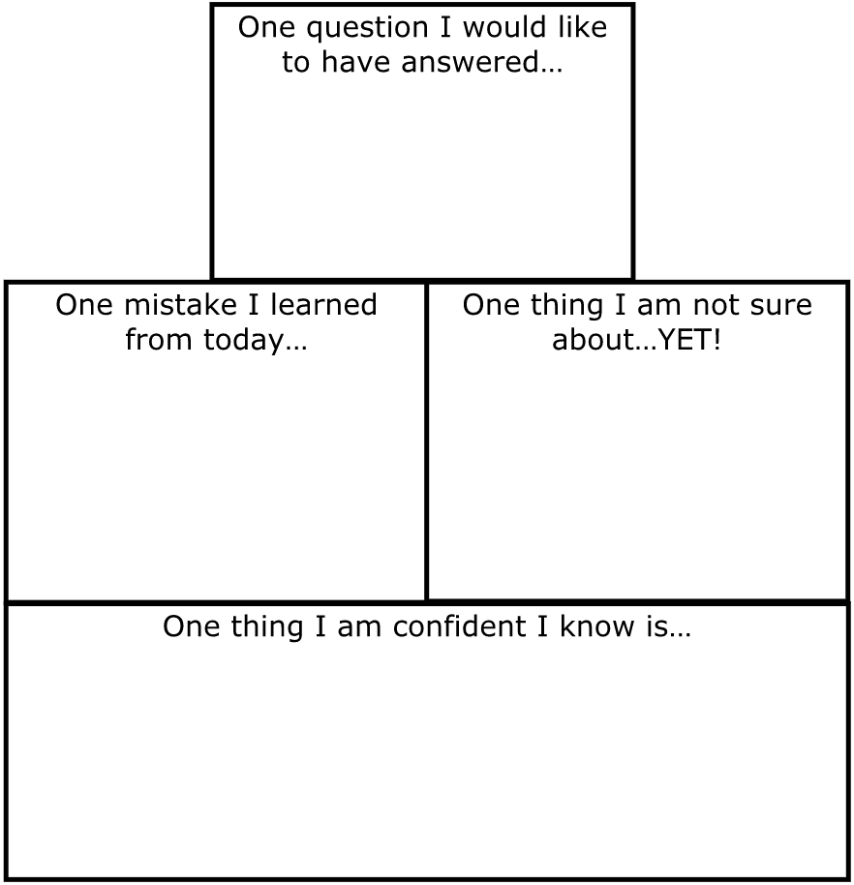
5.1.6 Wrap-Up: Reflection
Complete the learning pyramid.
volume 1, pg. 181

